Slide 1
Greenplum Workshop
Integrating Greenplum with Other Data Sources

Slide 2

Data Platform for Analytics
Business
Analysts
Data
Scientists
The world’s first open-source massively parallel processing (MPP) data platform for advanced analytics
Based on PostgreSQL
Developed since early 2000s
Open sourced in 2015
SQL 2003 compliant
Advanced cost-based optimizer
ACID transactions guarantees
USERS
IT
Dev
ANALYTICAL
APPLICATIONS
SQL
Custom Apps
BI / Reporting
Machine Learning
AI
NATIVE INTERFACES
ANSI SQL
Other DB SQL
ML/Stats/Graph
Programmatic
Text
GeoSpatial
JDBC, ODBC
Teradata SQL
Apache MADlib
Python. R,
Java, Perl, C
Apache SOLR
PostGIS
PIVOTAL
GREENPLUM
PLATFORM
Massively
Parallel
(MPP)
Petabyte
Scale
Loading
Query
Optimizer
(GPORCA)
Workload
Manager
Polymorphic
Storage
Command Center
SQL Compatibility
(Hyper-Q)
PostgreSQL
Kernel
MULTI-
STRUCTURED DATA
Structured Data
JSON, Apache AVRO, Apache Parquet and XML
SOURCES &
PIPELINES
Local
Storage
HDFS
Cloud
Object
Storage
GemFire
Spark
Other
RDBMSes
Spring
Cloud
Data Flow
ETL
Kafka
FLEXIBLE
DEPLOYMENT
On-Premises
Public
Clouds
Private
Clouds
Fully
Managed
Clouds
Notes:
But first of all, for people not yet familiar with Pivotal Greenplum I would like to give a short introduction.
… in 2015
Pivotal Greenplum delivers unmatched analytical query performance on massive volumes of data.
The Data Platform based on Pivotal Greenplum can be used by Business Analysts running BI reports, Data Scientists working with ML and AI algorithms and software developers working with custom applications. Greenplum is powered by an advanced cost-based optimizer, supports standard ANSI SQL interface, provides connectivity via ODBC / JDBC and includes libraries to work with large text, ML, programming languages such as R and Python and geo-spatial capabilities. It can manage multi-structured data, both internal and external, provides tools for integrating with external systems and can be deployed both on-premise and on variety of cloud platforms.

Slide 3






Modern Enterprise : heterogeneous data formats
structured data
unstructured data
{ semi-structured
data }
raw data
Notes:
We are saying: “Data tells the story”, it plays a central role in modern enterprises -- data must be captured, stored, processed and analysed quickly for a company to be successful and competitive.
But data is not uniform - it can be structured (such as data in database tables),
semi-structured (such as CSV, JSON or XML files) or unstructured.
Each data format requires customized processing logic and achieving an overlapping view of data becomes more and more difficult.

Slide 4








Modern Enterprise : wide variety of data engines
RDBMS
Notes:
The complexity is further increased by the fact that data of all possible formats can be stored in multiple systems based on operational requirements. These include analytical engines such as Pivotal Greenplum, cloud storage providers, such as Amazon S3, on-premise RDMS, in-memory grids, such as Pivotal GemFire, processing systems such as Apache Spark and Kafka and finally data lakes based on Apache Hadoop technology.
The data gets fragmented across multiple systems with different APIs and storage formats, making analytics across them a daunting task.

Slide 5
Greenplum External Table
CREATE [READABLE] EXTERNAL TABLE table_name ( col_name data_type [,...] | LIKE other_table ) LOCATION ('<protocol>://<path to data>...) FORMAT 'TEXT'
CREATE WRITABLE EXTERNAL TABLE table_name ( col_name data_type [,...] | LIKE other_table ) LOCATION ('<protocol>://<path to data>...) FORMAT 'CUSTOM' (Formatter=<formatter_specifications>) [ ENCODING 'encoding' ]
CREATE [READABLE] EXTERNAL WEB TABLE table_name ...
CREATE WRITABLE EXTERNAL WEB TABLE table_name
...
Provides the definitions for:
the schema of the external data
the protocol used to access the data
the location of the data in an external system
the format of the external data
Participates in query execution and allows plug-in connectors to external data for different protocols.
Notes:
The main feature of Pivotal Greenplum that enables access to external data is that of External Table.
External Table defines … (go over slide)
I should mention that with the help of external tables a user can not only read data from other systems, but also write data to them. It is also possible to get data from a remote HTTP server by using WEB external tables, but these are beyond the scope of my presentation.
At run-time, when a query executor encounters the need to fetch data from an external table, it finds a plug-in connector for a protocol specified by the table and delegates the further processing to it. We’ll call this connector “a protocol handler”.

Slide 6
External Protocol Handler
AVAILABLE PROTOCOLS
file:// -- for files on Greenplum segments
gpfdist:// -- for files on remote hosts
s3:// -- for files in AWS S3 bucket
gphdfs:// -- for files in Hadoop HDFS
(depreciated: use pxf instead)
http:// -- for WEB tables
pxf:// -- for data sources with JAVA APIs :
files in Hadoop HDFS
data in Apache Hive tables
data in Apache HBase tables
rows in RDBMS tables via JDBC
objects in in-memory grids
messages in queues
... build your own adapter ...
Provides connectivity to an external system
Implements methods to read data from the external system and write data into it
Defines the validation logic for external table specifications
Can be packaged as a shared library file (.so) and loaded dynamically
Notes:
The protocol handler is the logic that … (go over slide)
Here on the slide is the list of protocols for external access that Pivotal Greenplum supports. Traditionally these were oriented towards accessing files that reside either on the local file system of the Greenplum Segments, or on remote hosts or in the cloud.
There is also a protocol called “gphdfs” for accessing files stored in Hadoop HDFS. It works, but its operational characteristics and architecture could be improved. In addition, new protocol handlers need to be implemented in C programming language, which poses problems for systems that have Java APIs.
So the next-generation protocol was born to allow integration with wide varieties of systems, starting with Java-based Hadoop eco-system and extending to technologies such as JDBC and memory grids. It also makes integrating with a new system much easier by taking care of low-level Greenplum integration details and letting developers to focus to interactions with the external system by providing Java-based adapters. We call this protocol PXF.

Slide 7

Platform Extension Framework (PXF)
The Platform Extension Framework (PXF) provides:
parallel, high throughput data access
federated queries across heterogeneous data sources
built-in connectors that map a Greenplum Database external table definition to an external data source.
Available in since 2017 (5.1 release)
Apache HAWQ (incubating) launched in 2012 and was open-sourced in 2015
Based on Greenplum and modified to work natively with data stored in HDFS
PXF is used to connect to data in Hadoop ecosystem
PXF is open-sourced under Apache license
Notes:
The Greenplum Platform Extension Framework
(PXF) provides parallel, high throughput data
access and federated queries across
heterogeneous data sources. This provides the
ability to manage data on external partitions as if
the data was local. That means Greenplum can
read, write, and query data from anywhere, even
Amazon S3 or Hadoop data lakes.

Slide 8
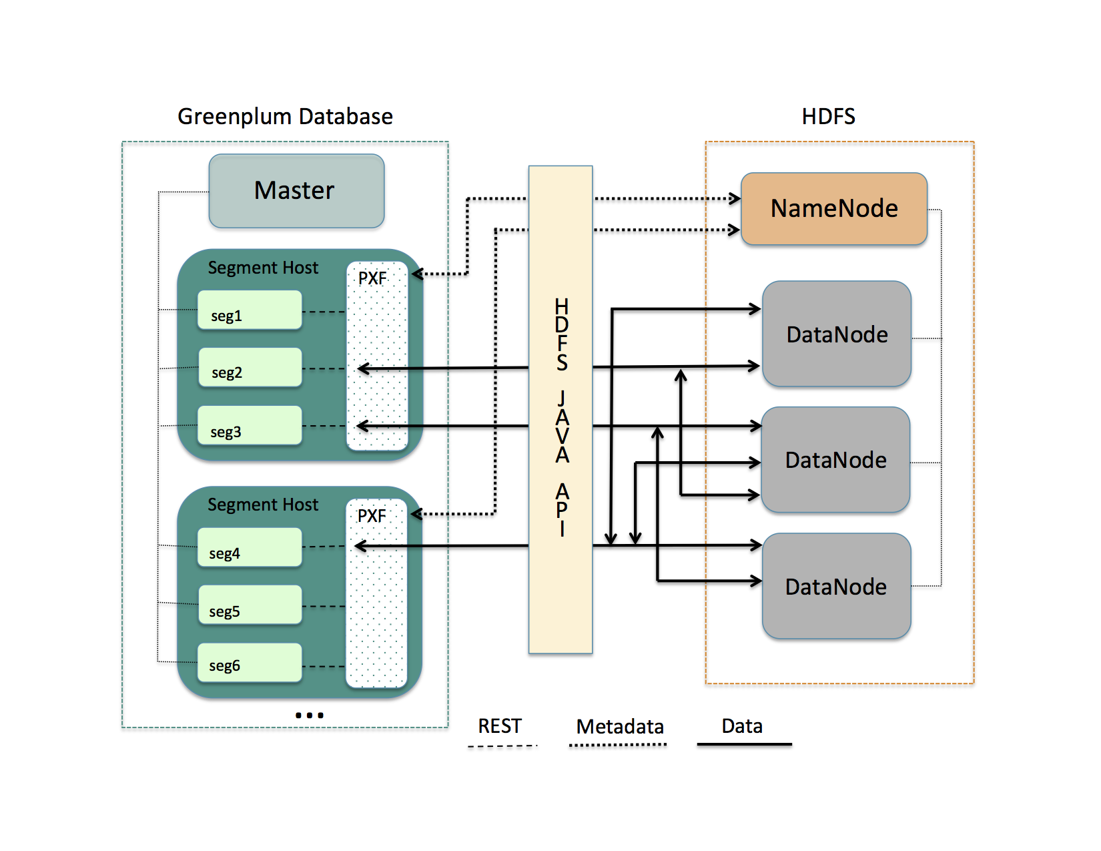
PXF > HDFS Data Import Flow
1. Master submits a query and segments start parallel execution
2. Each segment query execution slice gets a thread in PXF JVM
3. PXF asks HDFS Namenode for the information on file fragments
4. PXF decides on a workload distribution among threads
5. PXF reads data fragments via HDFS APIs from Datanodes and passes it to segments
6. Segments convert data into tuples and return them to Master
Notes:
Let’s consider the most popular use case of reading data from Hadoop HDFS into Greenplum:
External table with PXF protocol location would be defined
A SELECT query from this table is submitted to the Master
Master parses the query and instructs the segments to fetch data
All segment load the data in parallel, and each segment gets a thread in the PXF JVM
PXF asks Namanode for the list of file fragments and divides the workload among the segments
Each PXF thread reads its data using Hadoop HDFS Java APIs
Results are sent back to the PXF extension on the segment and then onto the Master
Combined results are presented to the client issuing the query

Slide 9
PXF Profile
A profile is a simple name mapping to
a set of connector plug-in class names
Implementing Fragmenter, Accessor and Resolver functional interfaces.
Profiles are useful when defining PXF external tables in Greenplum
HdfsDataFragmenter
LineBreakAccessor
StringPassResolver
HdfsTextSimple
Notes:
When users define external tables based on PXF protocol, they need to specify which Fragmenter, Accessor and Resolver to use. For their convenience, we introduced a concept of a Profile, which is a name for a pre-defined combination of these 3 specific components.
For example, the HdfsTextSimple profile is an alias that lets PXF know which specific components to use to handle text files stored on Hadoop HDFS.

Slide 10

PXF External Table
Register PXF Greenplum extension
Define an external table with:
the schema that corresponds to the structure of external data
the protocol pxf:// and the location of the data on external system
the profile to use for accessing the data
the format of data returned by PXF
cust, sku, amount, date
1234, ABC, $9.90, 4/01
1235, CDE, $8.80, 3/30
-- create extension only once per database
CREATE EXTENSION pxf;
-- define external table
CREATE EXTERNAL TABLE sales
(cust int, sku text, amount decimal, date date)
LOCATION
('pxf:///2018/sales.csv?PROFILE=HdfsTextSimple')
FORMAT 'TEXT'
Notes:
Finally, we will need to create an external table so that we can query the data.

Slide 11
PXF > HDFS Connector
Data Format | Profile Name | Description
Text | HdfsTextSimple HdfsTextMulti | Read delimited single or multi-line records from plain text data on HDFS.
Parquet | Parquet | Read Parquet format data (<filename>.parq).
Avro | Avro | Read Avro format binary data (<filename>.avro).
JSON | JSON | Read JSON format data (<filename>.json).
Notes:
Let’s quickly explore the connectors and profiles available with PXF.
The HDFS connector allows Greenplum and PXF to read data stored in Hadoop HDFS in 4 different formats.
Simple text format with field delimiters, JSON format and optimized storage formats such as Parquet and Avro.

Slide 12
PXF > Hive Connector
File Format | Profile Name | Description
TextFile | Hive, HiveText | Flat file with data in comma-, tab-, or space-separated value format or JSON notation.
SequenceFile | Hive | Flat file consisting of binary key/value pairs.
RCFile | Hive, HiveRC | Record columnar data consisting of binary key/value pairs; high row compression rate.
ORC | Hive, HiveORC, HiveVectorizedORC | Optimized row columnar data with stripe, footer, and postscript sections; reduces data size.
Parquet | Hive | Compressed columnar data representation.
Notes:
The PXF HIve connector allows users to query data managed by Hive.
It supports simple file formats such as Text and Json as well as optimized ones such as ORC and Parquet.
It’s worth noting that when reading data PXF does not dispatch the query to Hive execution engine, but instead reads and processes the underlying files directly.
That allows us to avoid the overhead of Hive query execution engine, since query processing is happening in Greenplum and we only need to supply the data to it.

Slide 13



PXF > Other Connectors
Apache HBase connector
JDBC connector (community)
Apache Ignite connector (community)
Alluxio connector (community)
Notes:
There are other PXF connectors available or in development.
A few of them were developed by members of the PXF community outside of Pivotal, which illustrates the power and scalability of the open-sourced development model.
We always welcome new contributions and I hope maybe some of you will be interested to develop a connector to your system of choice.

Slide 14
Appendix

Slide 15
PXF Fragmenter
Functional interface which
splits data from an external data source
into a list of independent fragments
that can be read in parallel.
Examples of fragments:
FileSplit in HDFS
Table partition in JDBC
SELECT
Fragmenter
Frag 1
ExternalData
Source
Frag 2
Frag n
Fragments
Notes:
Let’s look in more details into the PXF components that are needed to implement the flow we just reviewed.
The first one is -- Fragmenter -- its responsibility is to take the external data and break it into independent pieces called fragments such that they can be read in parallel by different PXF threads working on a query.

Slide 16
PXF Accessor
Functional interface which
reads a single fragment
from an external data source and
produces a list of records/rows.
Examples of a record:
Line in a text file
Row in a JDBC ResultSet
Fragmenter
Read Accessor
Frag 1
Row 1
Row 2
Row n
Fragment
Rows
Notes:
The second component is the Accessor. Its responsibility is to read the fragment and break it into a set of rows that would later be transformed into external table tuples.

Slide 17
PXF Resolver
Functional interface which
deserializes a record/row into fields and
transforms the data types
into those supported by Greenplum
Examples of a field:
Value between commas in a CSV line
Column value in a JDBC ResultSet
Read Accessor
Read Resolver
Row 1
F1
F2
F3
Fn
Row
Fields
Notes:
The third and final component is the Resolver, which takes a row, breaks it into a set of fields and their values and then transforms the values to types supported by Greenplum. For example, if text-based CSV file is to be sent to Greenplum in a binary format, number values need to be converted to integers before being placed into a byte stream.

Slide 18
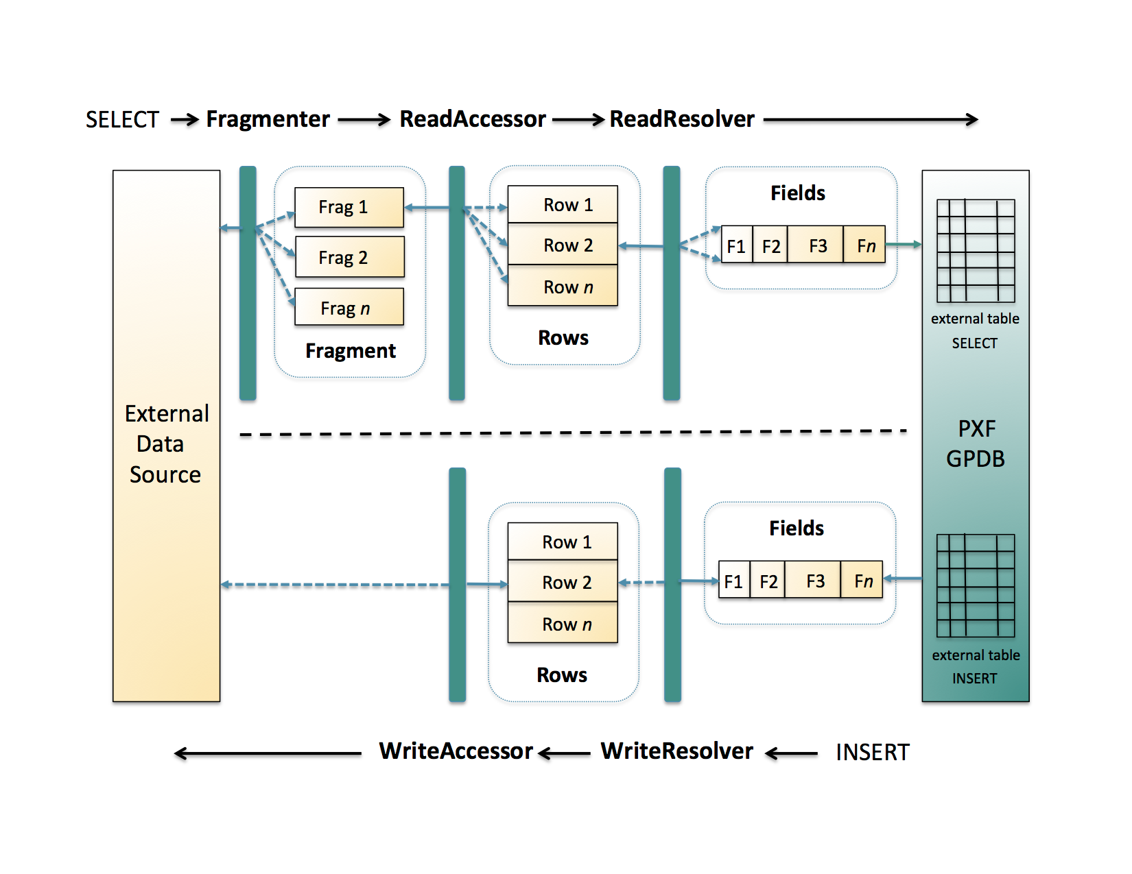
PXF > Data Flows Summary
Fragmenter, Accessor and Resolver working in combination
They can be specified as a pre-built profile or independently
Greenplum external table defines data schema, location, format and the profile to use to get the data
PXF can read the data from the external system or write to it
Export (write) Flow does not require a fragmenter since the fragmentation happens on the Greenplum side
Notes:
In summary, we learned how 3 different functional components work together to break the data from the external system into a number of fragments and then rows and then column values and send it to Greenplum to represent as tuples for an external table, which is a definition and abstraction of the external data.
Just a note, that GReenplum can also write to external tables, in this case the process is reversed, as data is sent from the Greenplum query executor to PXF, which processes the tuples, converts them to the target format and stores in the external system. There is no fragmenter involved in this flow as data is already fragmented by Greenplum segments.

